Slide 1



Curation Assessment of the Washington State Open Data Portal
Andrew Mckenna-Foster
Summer 2019
Washington State Library

Slide 2
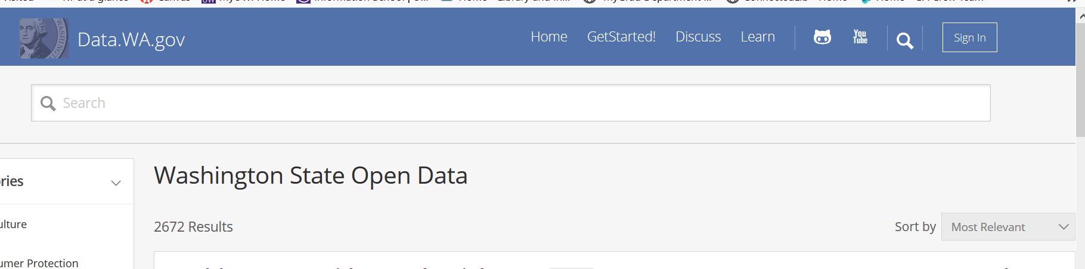
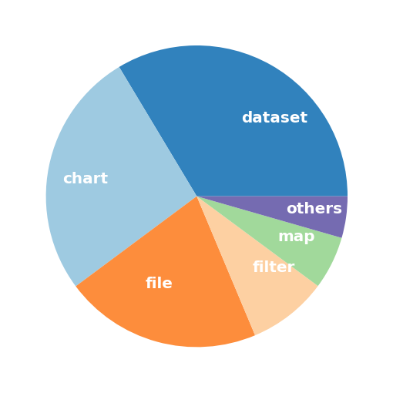
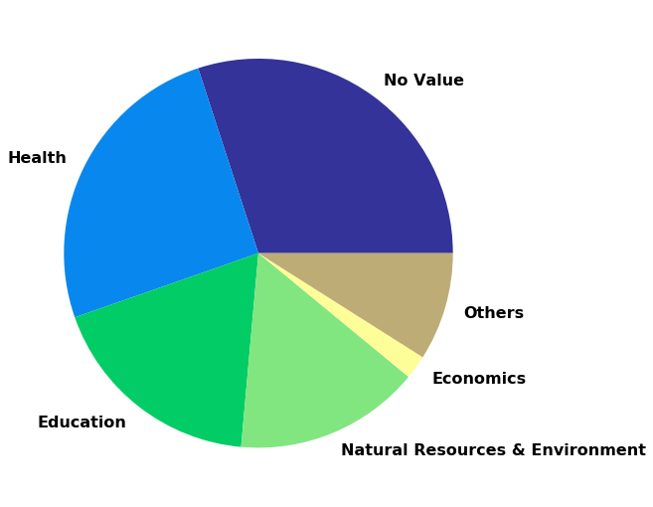
Started ~2009
> 2,600 assets
> 800 datasets
> 30 state agencies
Notes:
One of the more established state portals. Any state agency can receive permission to publish datasets. Currently there is no official curation. Will Saunders has nurtured this resource from the beginning, and it is now a highly regarded portal.
One reason for success (unmediated deposits) is also a possible cause of problems (poor metadata) – foreshadow with category pie chart.

Slide 3
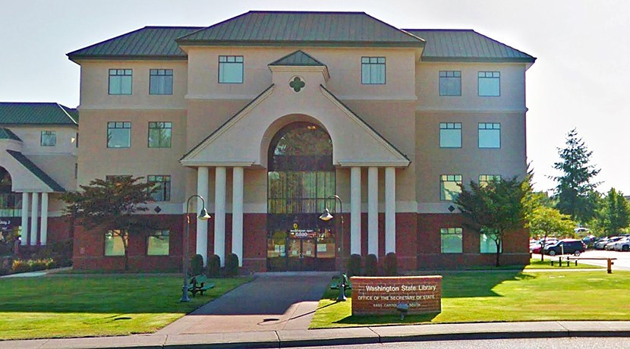
Curatorial Role for the State Library
Notes:
Is there a curation role for the State Library and what would that work look like? My job was to collect information that could inform this possible partnership and help a potential curator direct her efforts.

Slide 4
Project Overview
Interview agencies
Publishing behavior
Metadata assessment
How have metadata been assessed elsewhere?
Metadata existence
Data and metadata quality
Notes:
Focused on two things

Slide 5
Agency Interviews
Portal Use
Users
Future Plans

Slide 6
Agency Publishing is Diverse
Publishing Behaviors:
User focused
Upload and forget
Internal use
Transparency
Agencies view the portal positively
Users:
Other agencies
3rd parties: NGOs, Media
Local governments
Federal agencies
Citizen(s)
Most plan to continue or increase publishing
Notes:
I interviewed 8 state agencies and one organization that uses data from the portal. Publishers were very positive about the portal overall. The portal is being used to make government more efficient. Publishers use the portal in a variety of ways. Individual citizens are not the main users of the portal.

Slide 7
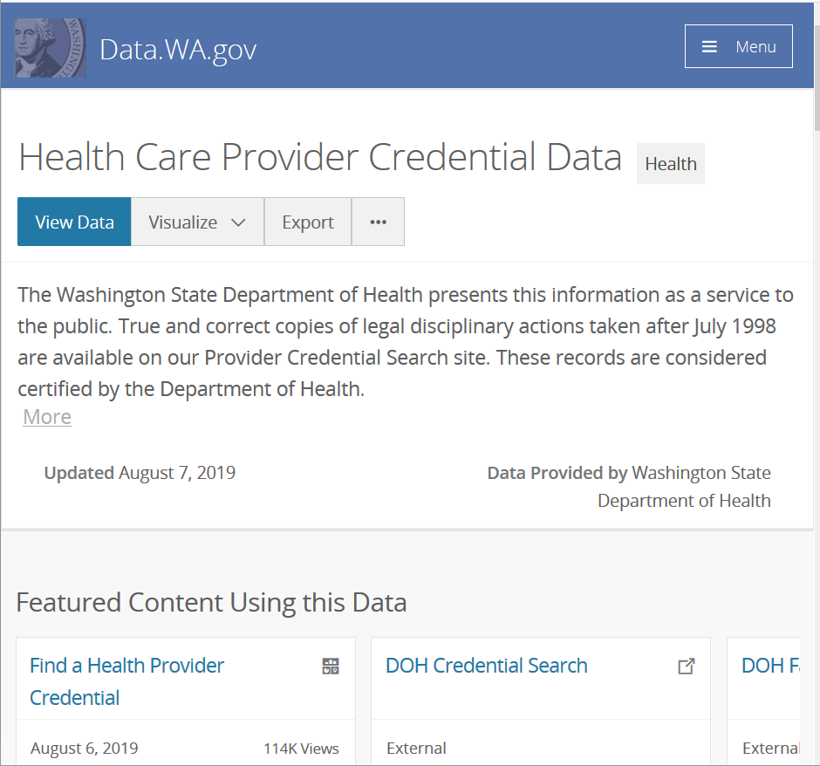
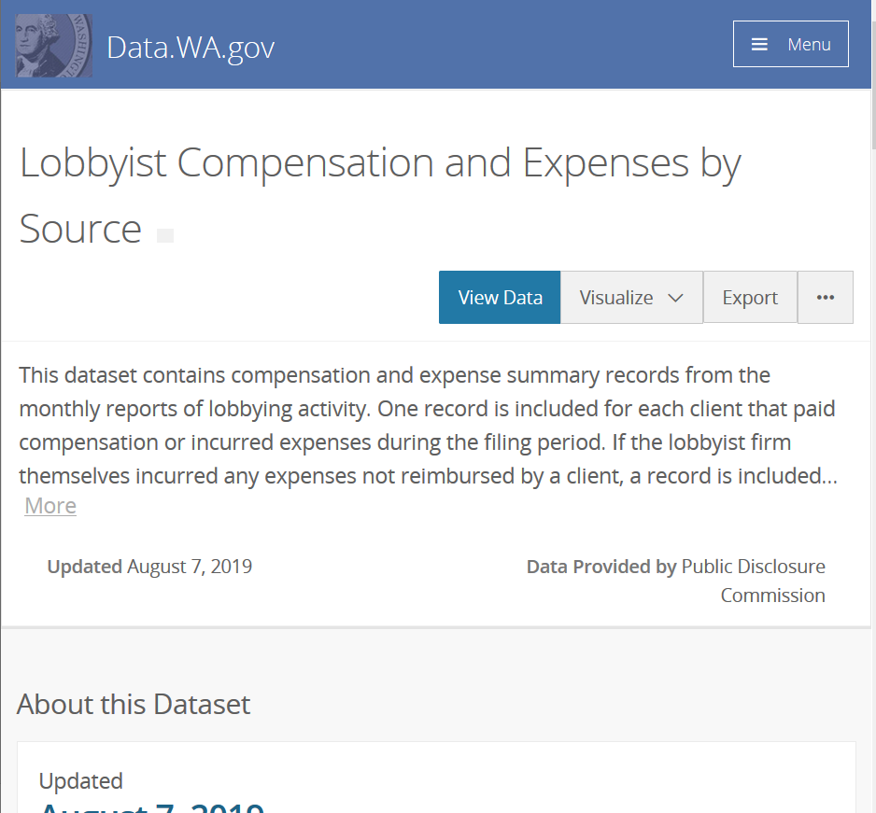
Notes:
Power publishers

Slide 8
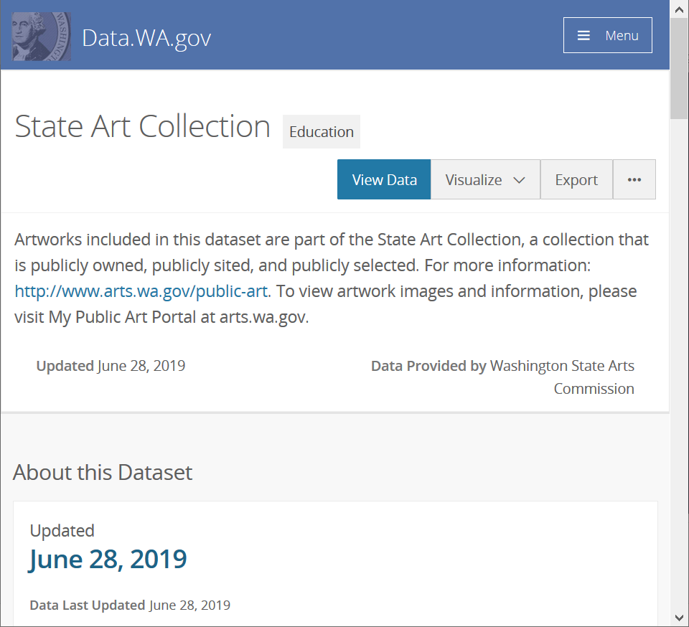
Notes:
Small publisher interested in doing more.

Slide 9
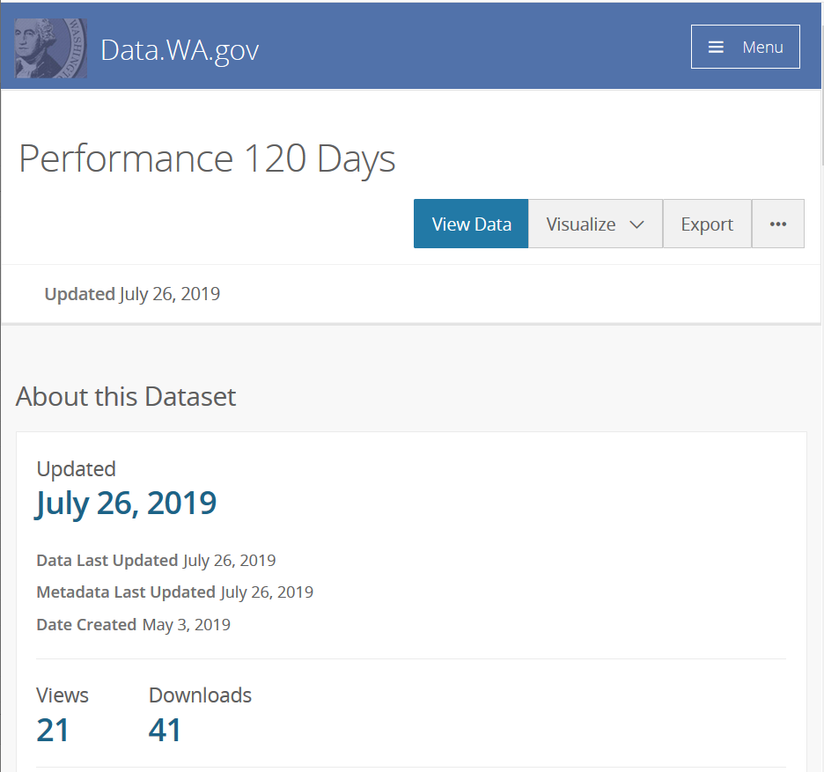
Notes:
Publishing for internal agency use.

Slide 10
What does this mean for curation?
Curator will need to work closely with publishers
Individual citizens are not the main users
Portal growth is likely
Library expertise are suited to navigating these needs
Notes:
Because agencies use the portal in so many different ways, curation work cannot be generalized. Curation work should also be focused on, though not exclusively, organization level users rather than individual citizens. The number of datasets on the portal is likely to grow. Cannot just impose new rules- the low barrier to publishing is part of the success.

Slide 11
Metadata Assessment
Existence
Quality & Understandability

Slide 12
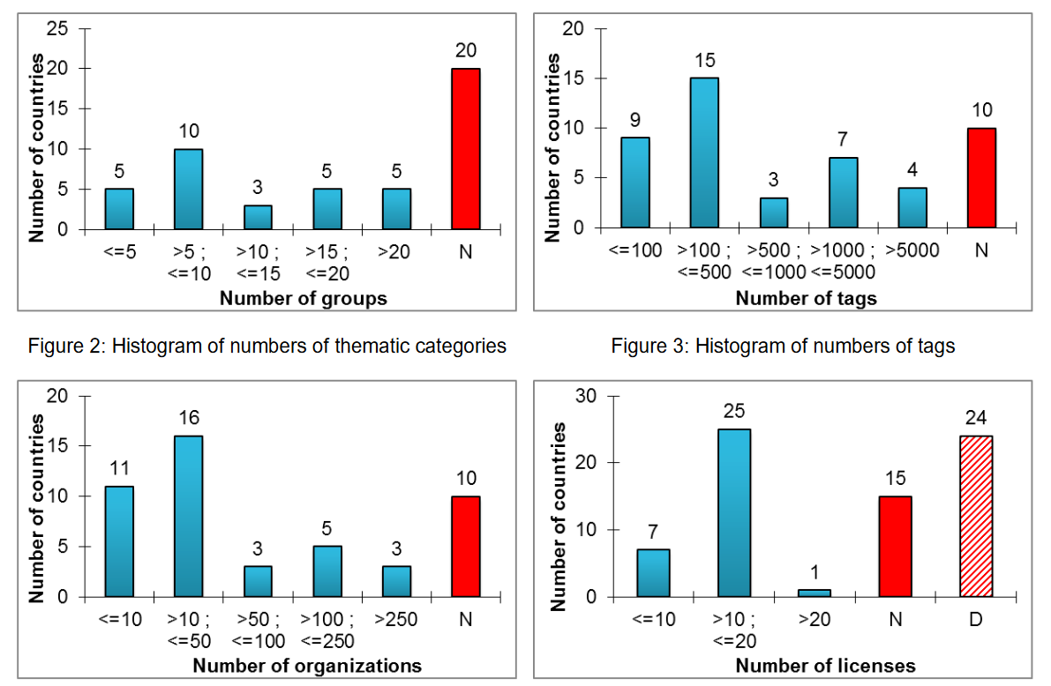
Low Quality Metadata - A Global Issue
“Open data quality – the next shift in open data?”
Open Knowledge Foundation 2017
Machova and Lnenicka 2017
Vetrò et al. 2016
Kubler et al. 2018
Umbrich et al. 2015
Notes:
Umbrich et al. 2015 - Majority datasets are around 60% complete
Vetrò et al. 2016 - ~90% compliance with e-Gov Metadata Standard
Machova and Lnenicka 2017 – Metadata quality averaged 65% +/- 11
Kubler et al. 2018 – Most portals fail to include temporal, spatial, license

Slide 13
Five Important Dimensions for Assessment
Format
Discovery
Owner Information
Temporal Information
License
Also important:
Data Dictionary
Notes:
These four dimensions are part of almost all assessments. Suggests that if publishers only fill out a few available metadata elements, it would be great if these areas were covered. License is often considered very important but in the case of data.wa.gov, agencies may purposively leave it blank if they believe that data to be public from its origination (agency legal counsel may recommend this).

Slide 14
Metadata Existence
Notes:
License, temporal values, originator and metadata language are least filled out.

Slide 15
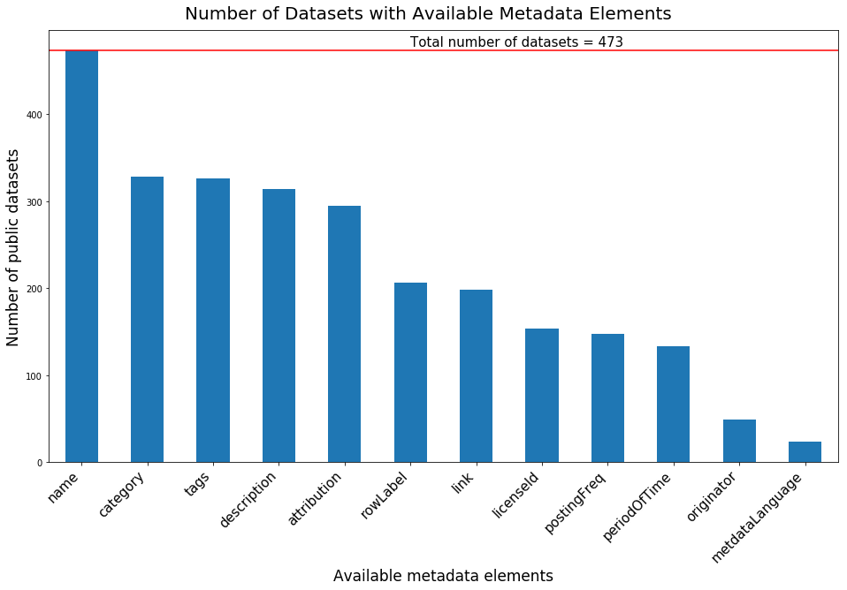
Notes:
License, temporal values, originator and metadata language are least filled out.

Slide 16
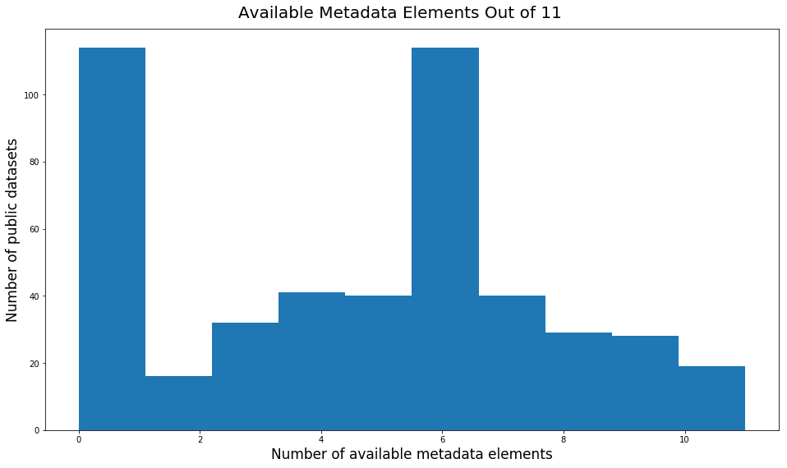
Notes:
Most datasets have 6 or fewer elements filled in. Note that many fill in none of the elements.

Slide 17
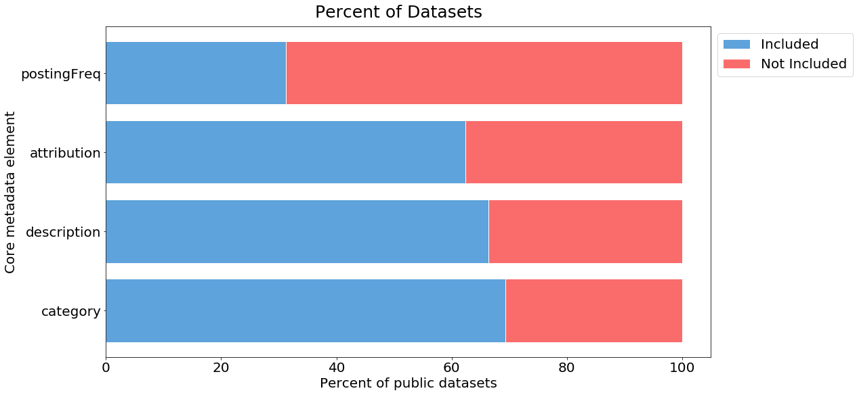
Notes:
Many datasets have at least one of the core elements complete. Over 20% have none though. Posting Frequency (monthly, quarterly, etc) is rarely filled in.
Similar to one other paper: Kubler et al 2018: Ckan portals. See fig 9 Qe(dis) [discovery] ~60%, Qe(tm)[temporal] ~0%, Qc(lic)[license]~25%, Qe(con)[contact]~75%. Didn’t really have an owner element.

Slide 18
Quality and Understandability
Sample of 112 datasets
Assessed:
Title, Description, Temporal/Spatial Information
Data Dictionary
Data Accuracy (values consistent in format?)
Curation Needs
Notes:
Sample of datasets spanning a range of number of downloads and creation years: 117 datasets selected, 5 had disappeared by the time I got to them. Subjectively assessed the overall quality of the metadata using a three-point scale. 0=metadata element not filled in 1=metadata element present but difficult to understand, 2=metadata element filled in and understandable

Slide 19
Dataset Titles
Snake Harvest
Master Content
DEL Office Locations
Snake Final Abundance 01022013
Coast Complete Metrics
Imaged Documents and Reports
WDFW-Adult Returns
Notes:
There are some mystifying titles

Slide 20
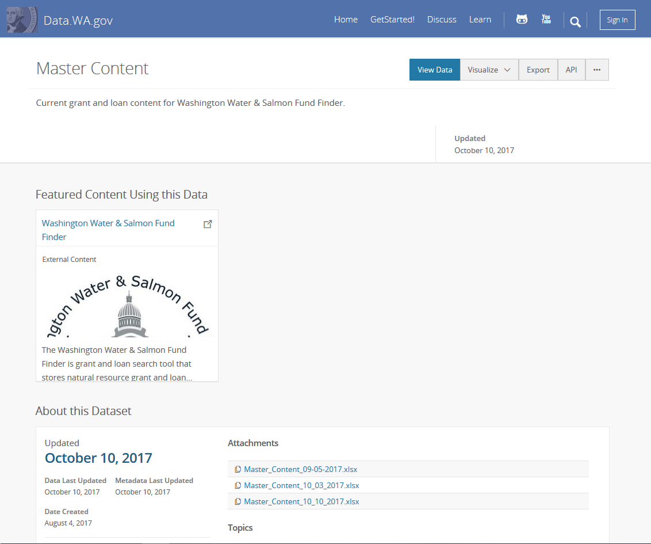
Notes:
Temporal problem

Slide 21
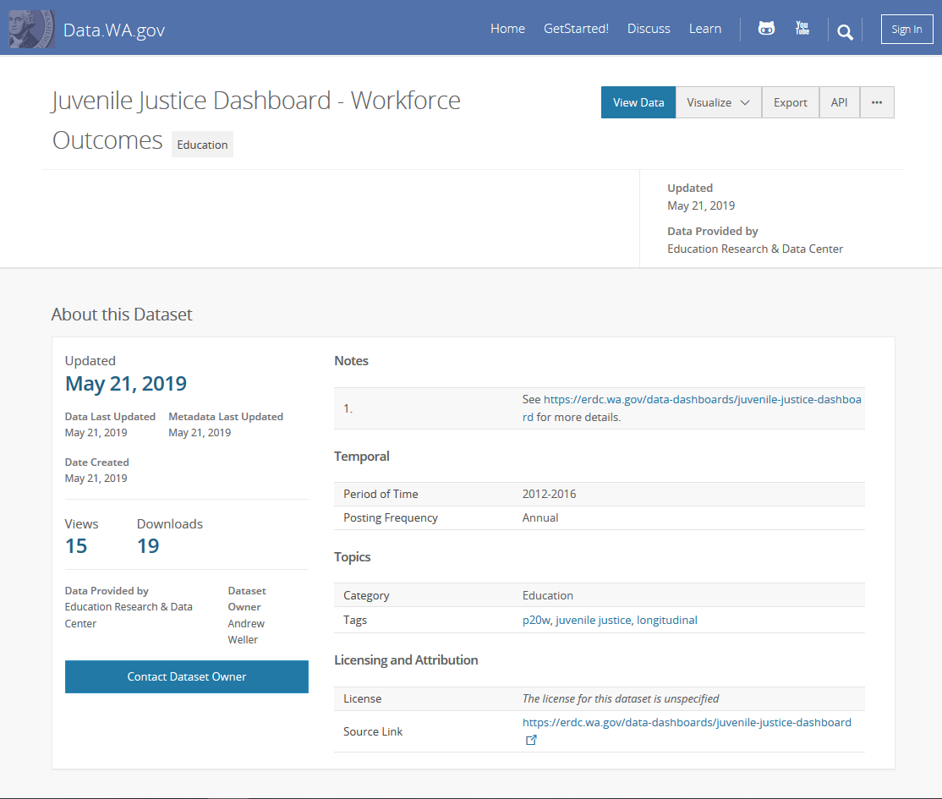
Notes:
Temporal problem

Slide 22
13% All core elements understandable 32% need one element 55% need two or more
Notes:
Temporal: about 23% were confusing, Of all the datasets, 14% had incorrect temporal information. Many titles are enigmatic, few provide data dictionary
Few papers mention data dictionary. Vetro et al 2016 does, few to none of the datasets they looked at had metadata for the columns at the municipal level- national level had good dictionaries.
Overall, only 13% are perfect when considering core elements and understandability

Slide 23
Other Curation Needs
Notes:
Multiple datasets in a time series
Uploads that are not data
E.g. links to pdfs
Mystery datasets
E.g. “1 – All $$ By Biennium” with no metadata.
Completely empty uploads and test/dummy datasets

Slide 24
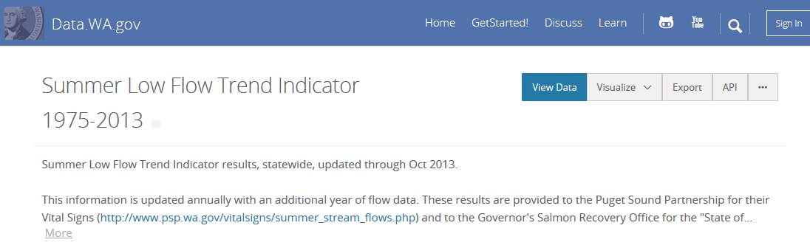
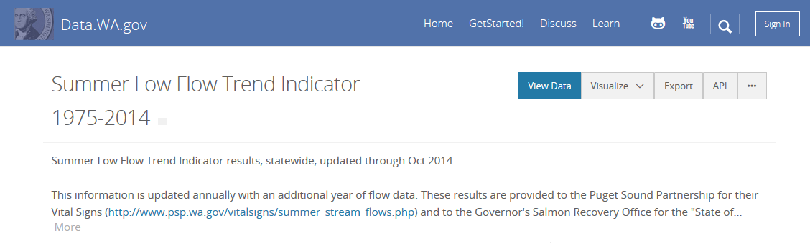
Notes:
13% of sampled seem to be candidates for an annually updated dataset.

Slide 25
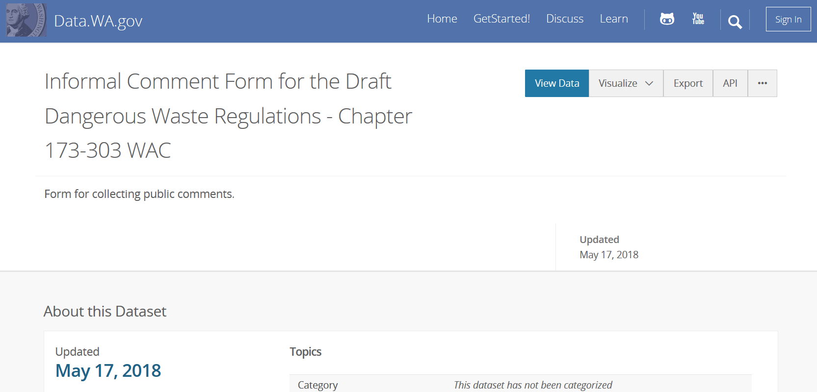
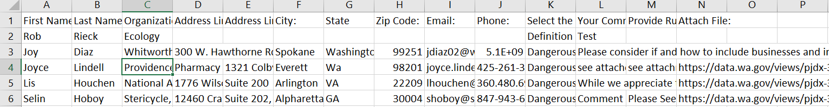
Notes:
Perhaps better on an agency website?
Data definition: https://ocio.wa.gov/programs/open-data/guidance-open-data-definitions

Slide 26
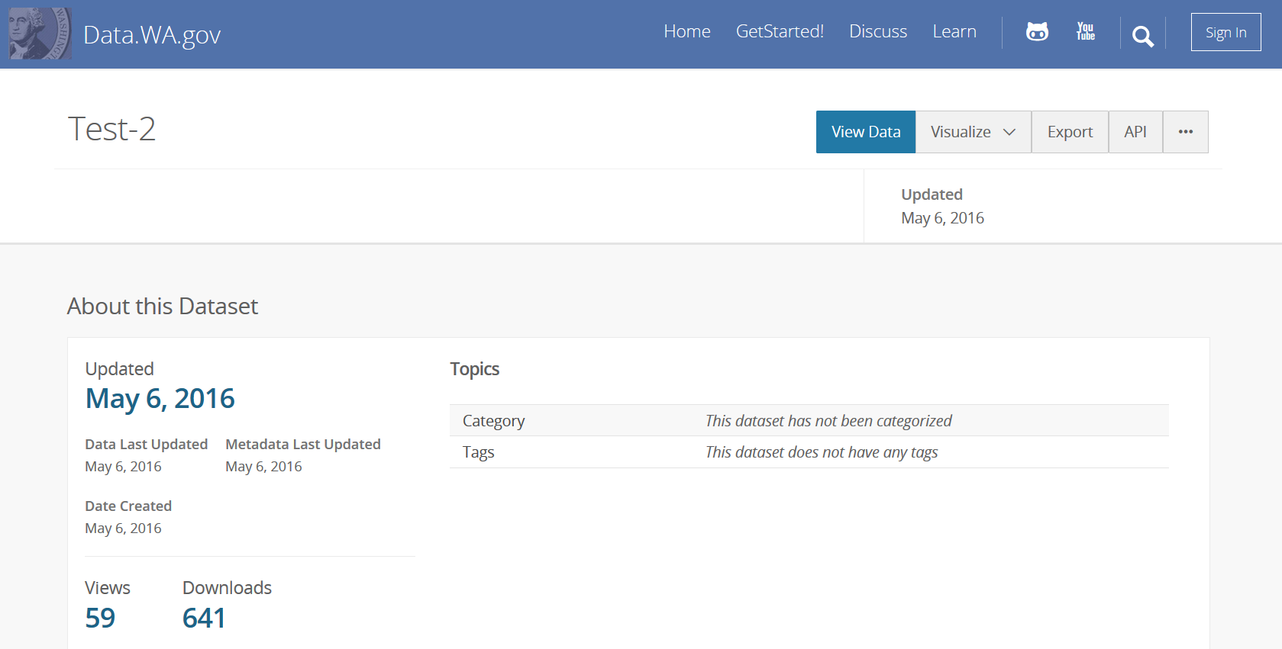
Notes:
Test dataset

Slide 27
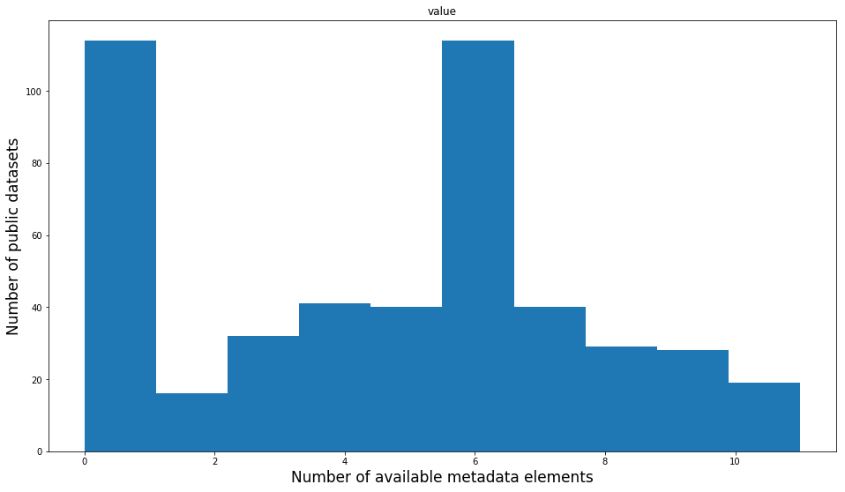
Quick Review
The portal is an important resource for Washington
Agencies use the portal to meet their unique data needs
55% of datasets need to improve two or more core elements
Notes:
Here are the major findings.

Slide 28
Recommendations

Slide 29
Insights
Data.wa.gov cannot be developed and weeded like a traditional library collection
Gradual improvements may be most effective
Curation will be a combination of:
Adjusting metadata requirements/guidance
Working directly with publishers
Gradual edits
Selecting datasets for removal
Notes:
Cannot control selection without completely changing how the portal operates. Its success is partly due to its low barrier to publishing. Gradual improvements, dataset by dataset and/or agency by agency, may be the most effective strategy. As opposed to sweeping changes or simply removing poor quality data.

Slide 30
What’s Next - Recommendations
Adopt a removal policy and procedure
Focus curation on the core metadata elements
Create stories to attract/inform agencies and users
Create a personable user feedback system
Run regular metadata assessments to evaluate curation
Notes:
Focus curation on the core metadata elements
Add controlled vocabularies where possible
Fix obvious temporal errors
Make titles understandable
Remove datasets that should not be public (not data, test)
Create stories to increase portal visibility
Create a user feedback system, Run regular metadata assessments

Slide 31
Questions
Presentation and all supporting materials:
https://github.com/OpenDataLiteracy/WSL-AMF
Acknowledgments:
Kathleen Sullivan, Will Saunders, Evelyn Lindberg, the staff at the State Library, the ODL Team, and all the agencies that assisted in gathering information.

Slide 32
Extra Slides – Various Figures

Slide 33
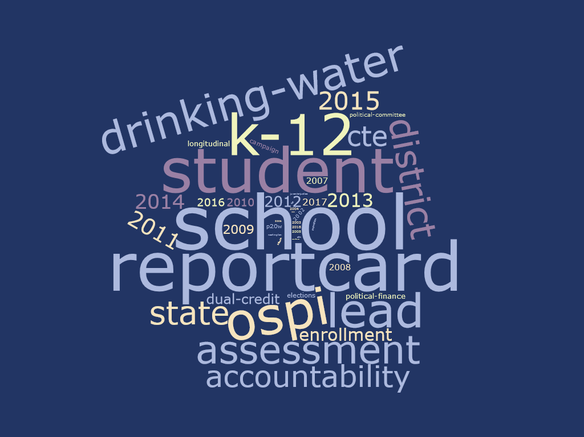
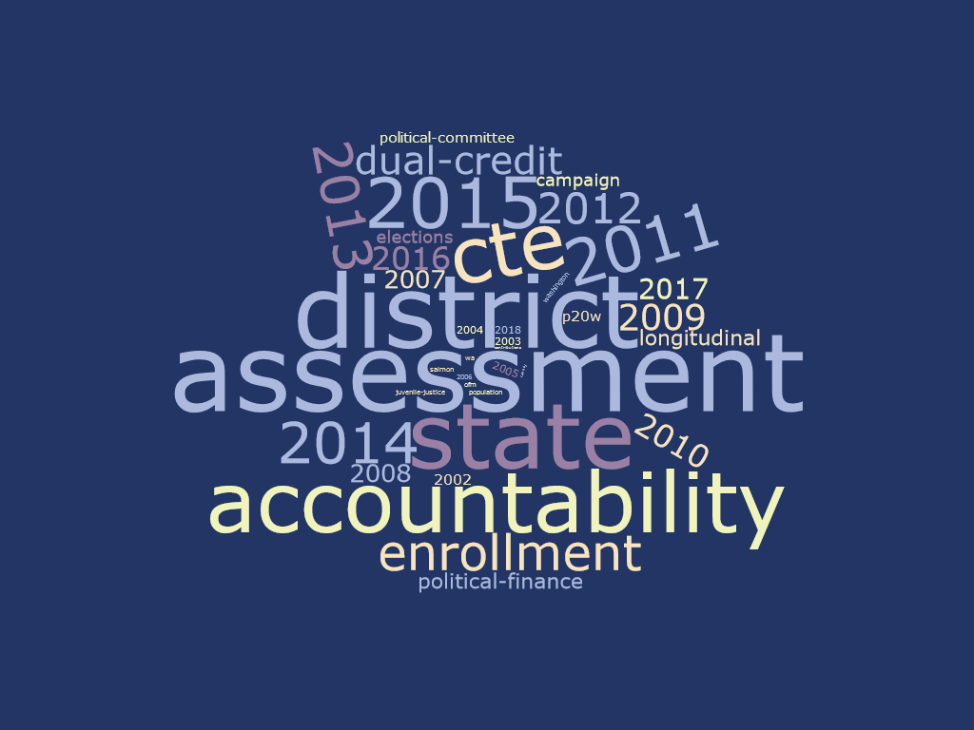
Tags
(Zoomed in)
Notes:
About 65% have tags
Median of 3 tags
Year is often included (most likely from school datasets). Other key words are not useful- ‘state’

Slide 34
State Portals are Distinct
Notes:
Top datasets from states represent way more categories that the top datasets from cities. Suggests each state is distinct.

Slide 35
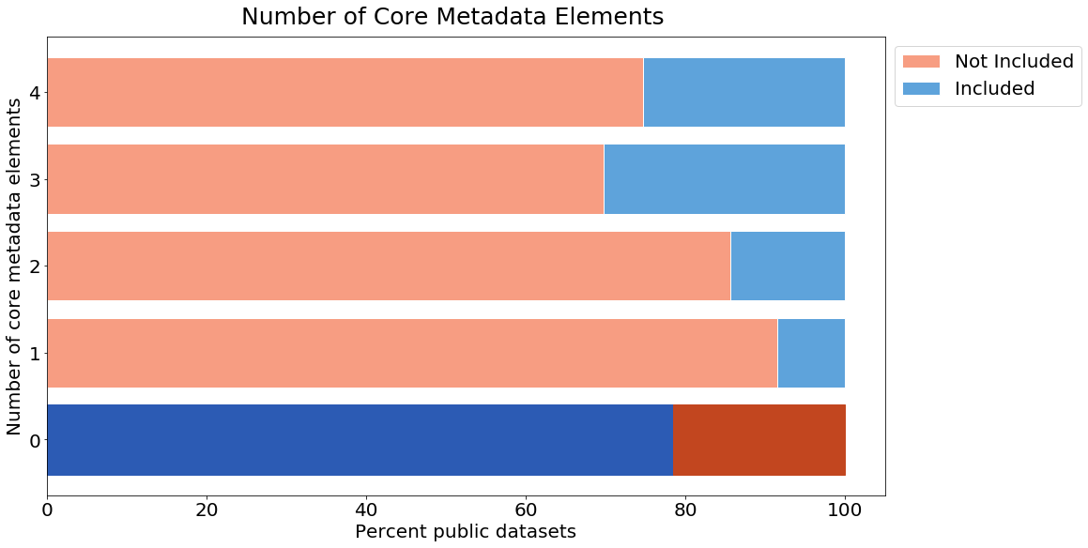

Slide 36
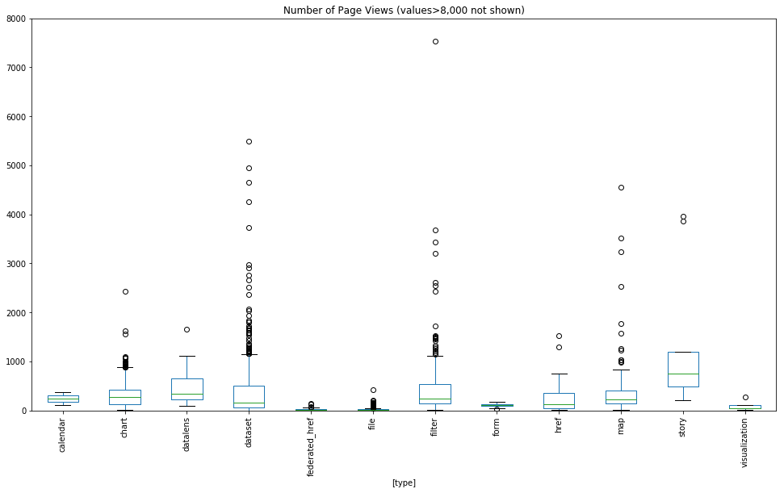

Slide 37
